Slide 1

The Journey of Artemus
By
Barry Duty
Developing New Worlds
At
Full Sail University
with
Josh Collier

Slide 2
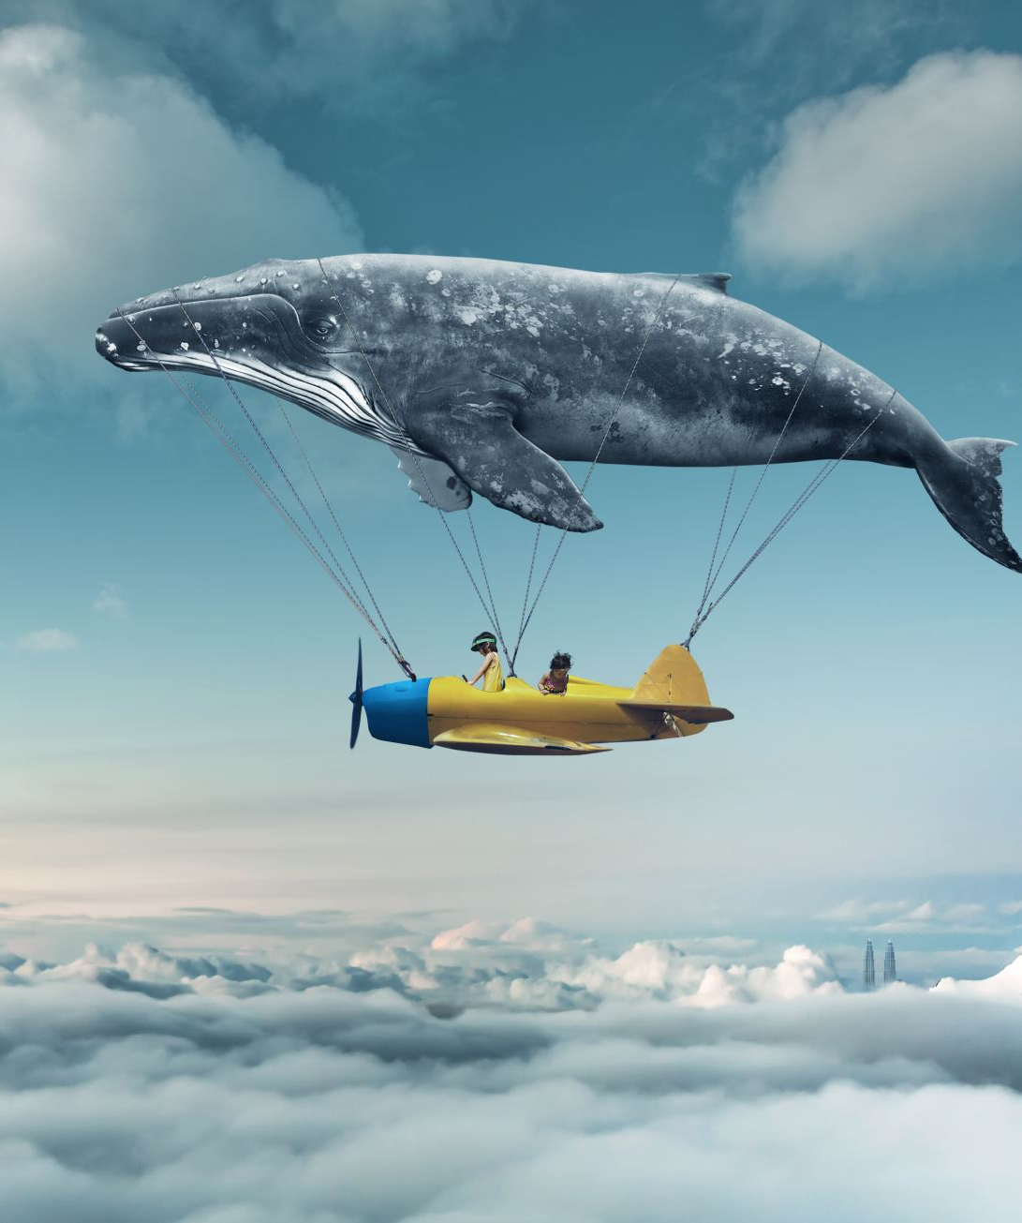
The Journey of Artemus
Deep in the forest, a young eagle has never known anything but the safety of his nest, until the day his mother tells him it’s time to fly. Terrified and clinging to her wings, he begs her not to let him fall. But his mother knows something he doesn’t : an eagle can’t become who he’s meant to be until he learns to trust. A tender story about courage, letting go and the leap of faith every young heart must take.

Slide 3
Historical Background Information
Important facts about Artemus’ world. In the last hundred years there has been human advancements into his world. The forest still exists but is shrinking with the human presence growing yearly. Predatory animal population is increasing and with this the food supply is getting smaller. With the increasing technology of man, the eagles are being exposed to more dangerous chemicals invading their environment. Artemus must take in all this information and do everything he can to protect his family and clan from becoming extinct in the long run. He posses an innate understanding without verbal language. He takes calculated introspection: Reasoning before action.
Artemus has a call to duty of sound decision making and remain virtuous. He has plans to build an alliance with the members of his family and clan to help keep everyone safe. His realization of coordinated networks possibilities helps him establish lead birds and information network to solidify his position as protector and statesman. Artemus takes charge of generational change and adaptation for his world. He will combine old wisdom and new challenges to help keep tension low key. Family loyalty and extended community care, keeps the clan together. Artemus practices leadership through understanding rather than dominance. He focuses on individual gifts contributing to the collective strength.

Slide 4

Historical Background of Information continued
Artemus keeps up to date on his family by flying across two hundred miles of territory that his clan inhabits. The location of this territory is a place called Sand Point, just off the southern part of Lake Huron in Michigan. This terrain is flat and the perfect place for safety and the Headquarters for the Executive Alliance of Eagles.

Slide 5
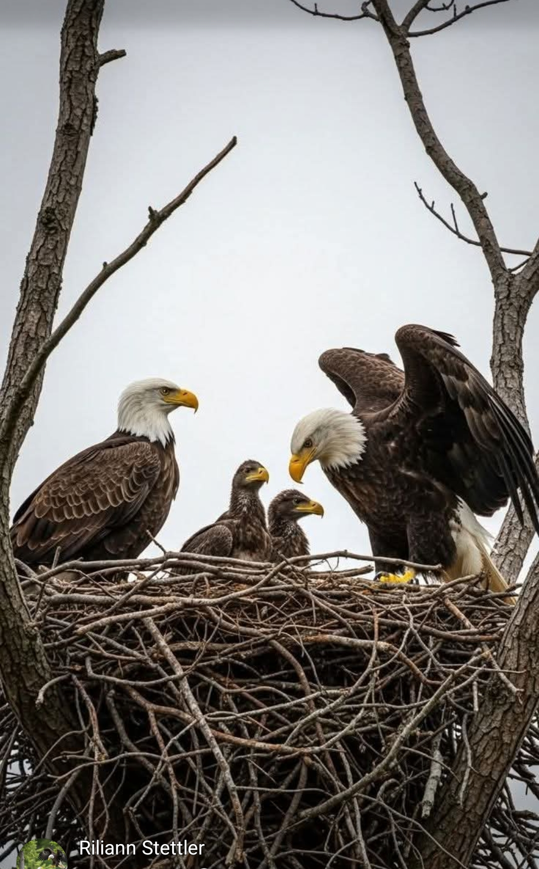
Main Character- Artemus
An exceptionally observant and thoughtful eaglet born into a powerful eagle family. Demonstrates wisdom beyond his years, strategical thinking and an innate ability to understand other’s gifts and strengths. He will become one of the families most powerful leaders and organizer that they have ever had.
His life stages:
One: Starts as an ordinary egg
Two: Hatchling to fledging
Three: Adolescent (learning and training) brown in color
Four: Pre Adult (Physical and emotional maturity the scraggly molting period) starts to change in color, speckled appearance.
Five: Full adult (five to five and half years old, complete white heads and tail, yellow beak. Assumes leadership role)

Slide 6
Main character continued
Artemus’ mother, Darlene senses something different about him when he is a young eaglet. She makes sure to nurture and encourage his abilities to make him strong.
Artemus is about to have his fledgling flight, and the fear builds up in him, but his mother reassures him that to be an eagle he needs to trust her and learn from her. For him to one day, be in charge he needs to fly. His first experience is very frightening, Artemus holds tight to his mothers back and she flies straight towards the sun. Eagles have three eyelids: they have a golden color one that helps them see in the bright sunlight. They can look straight at the sun and have no ill effect on their sight. Darlene tells Artemus this, so that if he is ever chased, all he needs to do is head straight into the path of the sun. As his mother reaches extreme heights, Artemus falls off his mother’s back and tumbles towards the earth. He calls out to his mother to save him. She lets him fall for a short distances for she knows she can catch him before he hits the ground. You see eagles can travel very fast up to 100 miles an hour in a dive, with a wingspan of approximately seven and half feet, so, she will catch and save him. As she dives, she catches him and he latches on to her back again. She tells him that he must learn to trust his abilities to be a strong eagle.

Slide 7
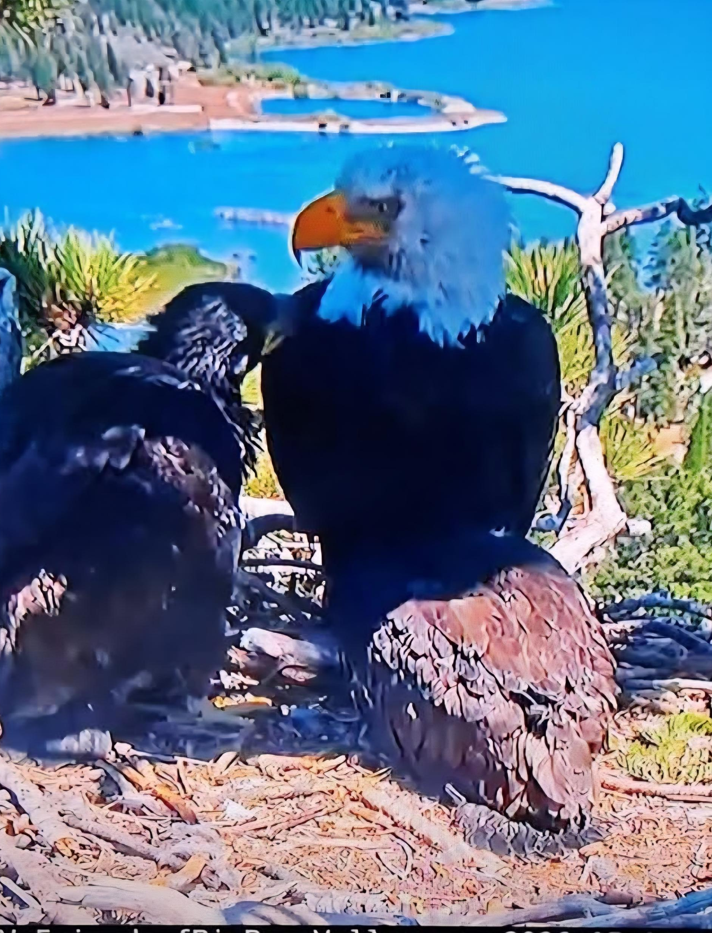
Darlene-Mother
Darlene is Artemus’s mother, she is a warrior, protector, a wise nurturing soul. She senses her son’s exceptional nature from birth. She is his teacher, food supplier and all things good and strong in Artemus’s eyes. Darlene is a fierce fighter and is undefeated in battle, until she’s is injured protecting her brother in a territorial fight. She tries to instill loyalty and trust in her son and train him in the ways of a very prominent eagle and to take his place in the hierarchy of the clan. This is her major role in life, to raise excellent eaglets to take their place in this world to bring joy and enlightenment to the family and clan.

Slide 8
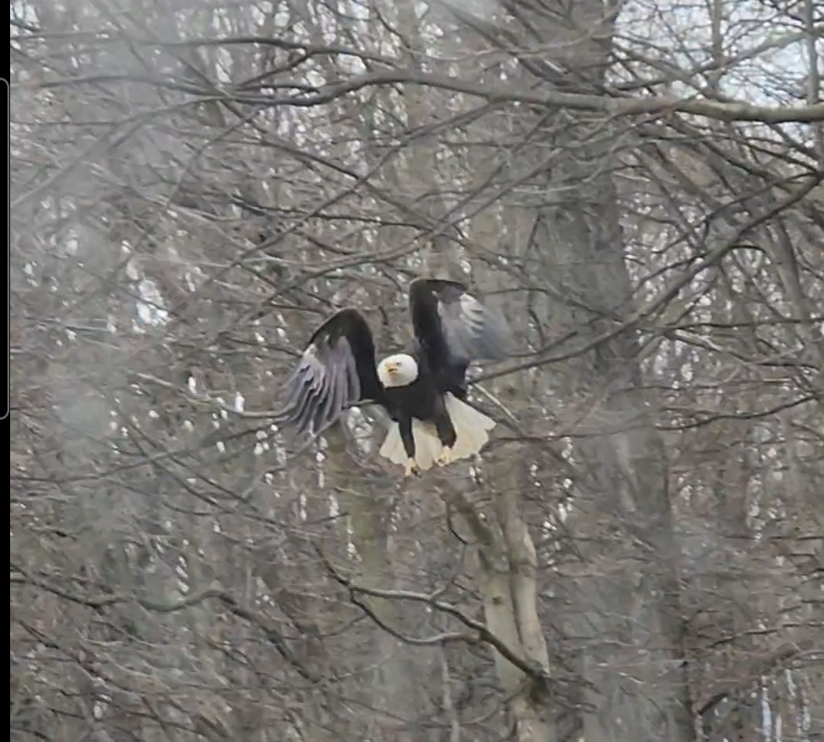
Herston –Uncle
Herston is a very hands on, uncle to Artemus. He becomes a mentor figure during the eaglet’s adolescent phase. Here he sets out to be there and help with any questions he might have in becoming a full grown, bald eagle. But that was almost not to be. Artemus’s uncle was severely injured in a very brutal territorial fight, along with Artemus’s mother, who came to rescue her brother, but became severely injured herself. Their sister who is the seventh daughter of a seventh daughter came to help them with her gift of healing. With the help of his sisters, he survives and helps Artemus in the future.

Slide 9
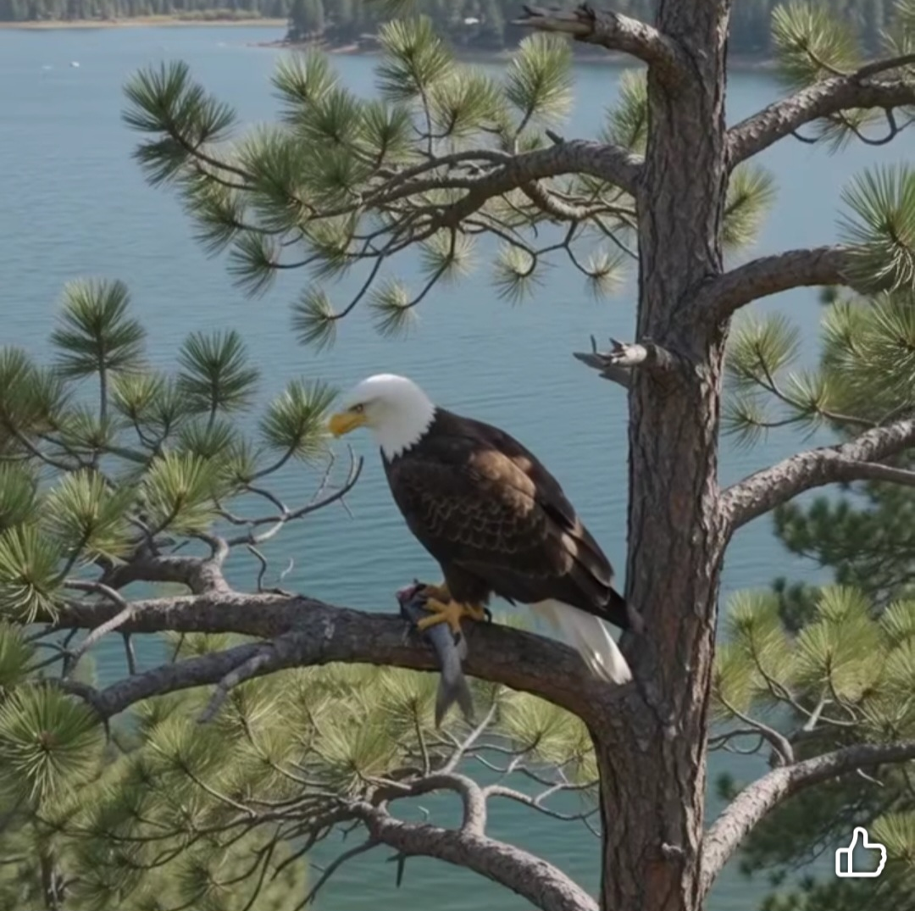
Norville-Father
Artemus’s father is a statesman, protector, and steps in during his wife’s recovery to help raise Artemus. He takes over training Artemus in his flying and bring his food until Darlene can start again. This should not be long with the healing powers of Darlene’s sister gift. Norville is a good father, he does help with the eaglets, but mostly he is involved with the daily activities of the Alliance, and here is where Artemus will learn to be the statesman like his father to lead the family and clan in the future. This episode in their lives makes them closer than they would have been if it hadn’t happened.

Slide 10
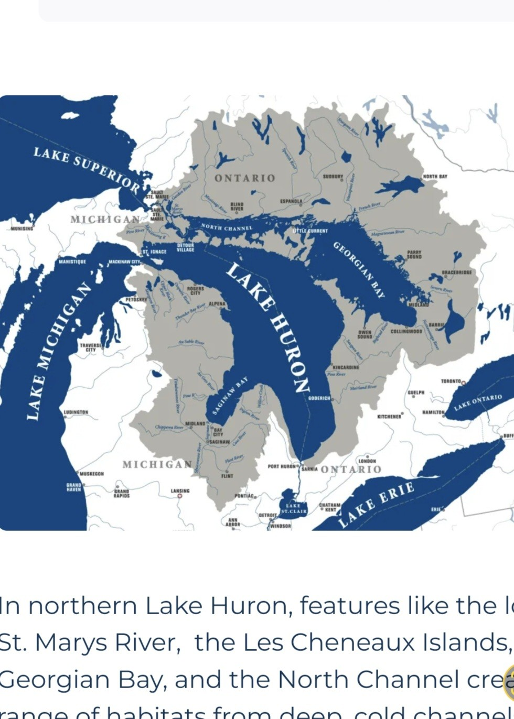
Water
The eaglet was born at Sand Point at the southern point of Lake Huron. The second largest by surface area and the third largest by volume, featuring a surface area of 23,000 square miles. The average depth of 195 feet and the longest shoreline of all the Great Lakes. Maximum depth is 250 feet. It overflows into the St. Clair River to Lake Erie. On the west side of the bay has an enormous fish and wildlife of any other Great Lake. On that Lake, there is an Island, it is the largest island on any U.S. Lake, from this point they can see for miles.

Slide 11
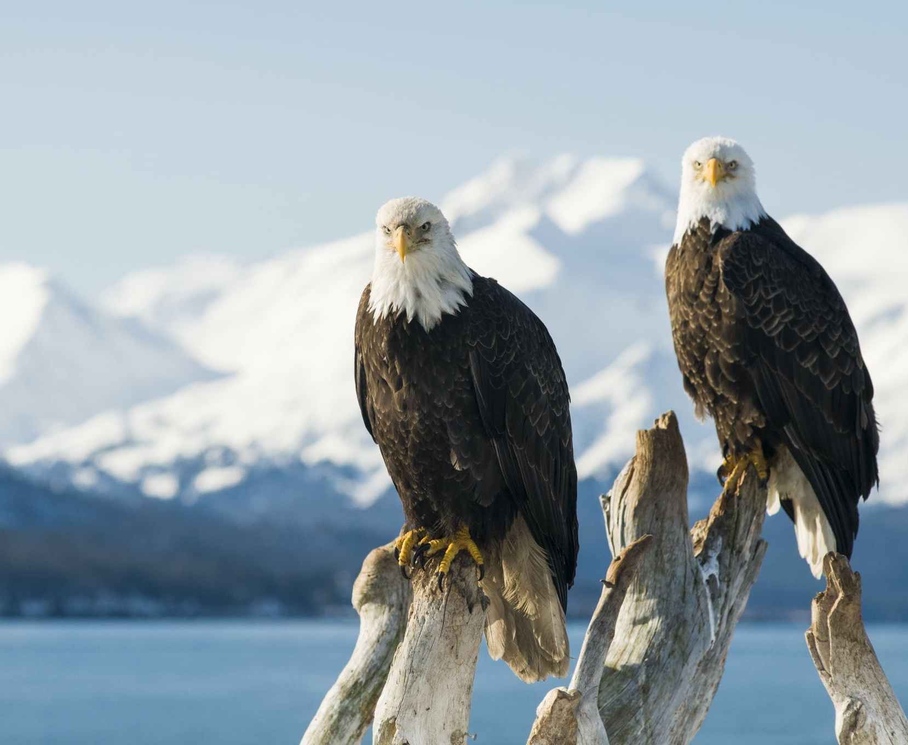
Nest
The adult eagle has a wingspan of six to seven and half feet. Artemus’s nest is eight to 9 and half feet wide and eighteen ft deep. The largest nest on record is nine and half feet wide and twenty feet deep and weighs 4,400 pounds. It takes a pair of eagles one to three months to build it, and they work on it for years each spring. Adding fresh sticks and furs and moss. They add to the nest one to three weeks before they lay eggs. The nest of Aunt Delphine was one of the largest in their world and when Artemus builds his a two tiered, nest weighing 5,400 pounds. Each family in their lineage were big nest builders. Their source of limbs come from Hemlock.

Slide 12
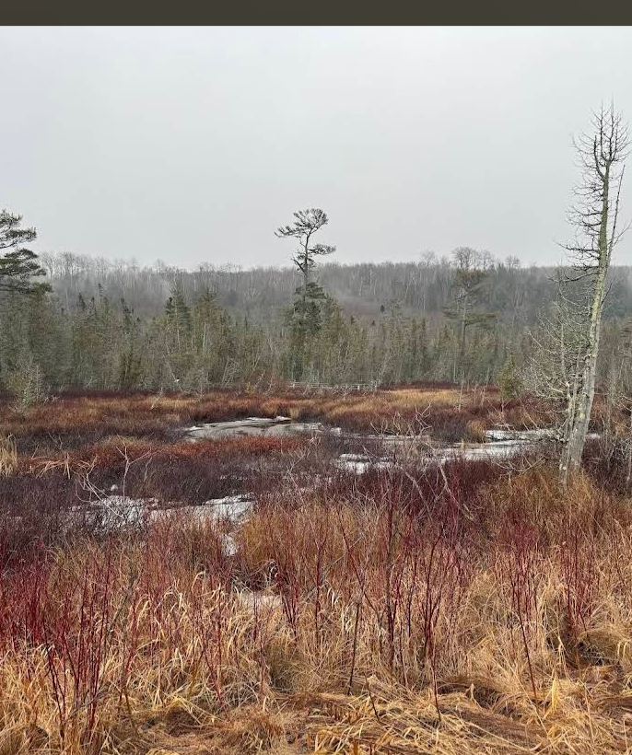
Terrain
Top predators include lake trout, Chinook, salmon, and massive walleye stock. State agencies record millions of fish caught by anglers annually, detailed in reports. The terrain by Sand Point contains woodlands of mature trees, including, hemlock groves, very rough and old growth Woodstock. The Port Crescent area on the shores of Lake Huron in the thumb of Michigan’s thumb region. It is an excellent habitat with highly active and visible enormous eagle population. Broadly across Lake Huron eagle sightings. As of 2026 Michigan boosts approximately 900 breeding pairs. Many of which are Artemus’s extended family. The population was 52 in 1961 and now there are bird watching sites that are considered premier observation points.

Slide 13
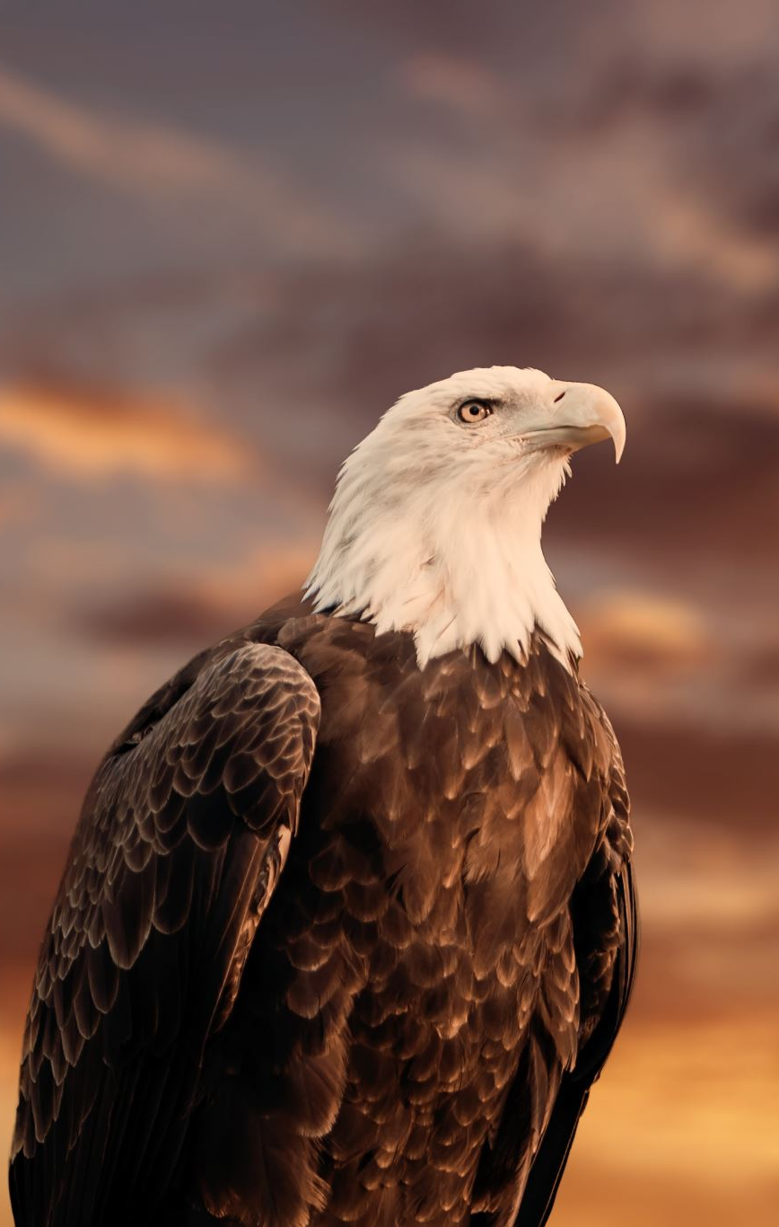
High above the jagged edge of the massive nest of a highly influential and powerful family, sits a young eaglet whose name is Artemus. He was born to rule but before he can claim his birthright, he must first master the sky. He father, Norvell, is a brilliant and highly respected statesman who skillfully navigates the clan’s complex political webs, silently grooming young Artemus to inherit the mantle of ultimate authority. His mother, Darlene, beautifully balances two entirely different worlds: she is a fierce warrior on the battlefield, yet a deeply kind, compassionate, and nurturing soul at the nest. She provides Artemus with the emotional strength and love he needs to survive.
The clock is ticking rapidly for the young prince of the air. Artemus needs to learn to fly incredibly soon, as the future stability and survival of the entire clan heavily rest upon his physical development. As the sole heir to this legendary family legacy, he is destined to eventually take over as the main leader of the flock. However, the path to the throne is fraught with immense psychological pressure, rigid social expectations and hidden political rivals who are eagerly waiting for him to fail his initial flight trails. Artemus must urgently find his own wings, blend his father’s sharp diplomatic statesmanship with his mother’s courageous, protective warrior spirit. To secure his future, he must prove to the ruling council that he can rise above the storm clouds and successfully protect their vast territory.

Slide 14
The Journey of Artemus
Artemus, a young eaglet born to the formidable warrior Darlene, learns to soar under his mother’s wing, through her patience yet unwavering guidance. From his first uncertain flights, when fear threatens to pull him down toward earth, Darlene teaches him that trust and courage are the true wings that carry eagles skyward. His father, a proven statesman, provides stability and wisdom during these formative years. His uncle, nearly defeated in a brutal territorial dispute, becomes an unexpected mentor during his recovery. A time when Artemus witnesses firsthand how his aunts extraordinary healing powers mend not just physical wounds but also restore purpose and dignity. During these formative hours spent at his uncle’s side watching his Aunt Delphine’s ancient knowledge work to rebuild what was broken. Artemus grasps a profound truth, true leadership means understanding each family member’s unique vulnerabilities and strengths, orchestrating them into a unified whole where no one fights alone. As Artemus matures through each growth stage, he rises to become the most exceptional eagle in his entire region, his white crowned plumage marking him as a leader destined for greatness. He claims command of a vast two hundred mile, territory uniting a massive family network, spread across the land , each member possessing unique talents and capabilities. There, he establishes a carefully balanced family hierarchy among his brothers and sisters, uncles and extended family. A structure born directly from those lessons learned at his uncle’s bedside, unifying their individual strengths into one force. This new order creates a safe haven where his family can thrive without fear of human encroachment, predatory threats or territorial disputes. Drawing upon the ancient healing knowledge of his seventh daughter aunt and the tactical wisdom passed down through the generations. Artemus weaves together protection, provision and purpose. Through love, leadership, and unwavering determination he transform from a frightened fledging plagued by self doubt into a visionary protector and statesman for his entire kind forever changing the landscape of eagle society.

Slide 15
Resources
http://www.epa.gov, U.S. Environmental Protection Agency.gov
http://www.DNR.gov, U.S. Department of Natural Resources.gov
http://www.NPS.gov, U.S. National Park Service.gov, [Public Domain Photo]
Lakesuperiorcircletour.info, Sand Point Beach, Picture Rock National Park,[photograph]
Duty, C.(2025),[ Eagle in flight],[photograph].
Pexels-triemli-28598671.jpg,[nest in tree],[photograph].
Morris, M. (2026), [mother in nest], [photograph].
Stettler, R.(2026),[eagle family],[photograph].
PowerPoint template photograph [eagle]

